Slide 1
Release 4
Senior Design
Notes:
Taher

Slide 2
Project Background
Notes:
Taher

Slide 3
Introduction
What is our project?
To design and create a process that allows users to control hardware that captures and provides consistent high quality photos in a 360° view to be saved to Spreetail’s storage.
Involves three major components
User-friendly front end
Hardware setup to capture images
Communication between web app and hardware
Notes:
Taher

Slide 4
Introduction
Why is this project important?
Simplify photography process
Provide consistent high quality photos
Photos will be used on Spreetail.com
Set Spreetail apart from competition through photography
Notes:
Taher

Slide 5
Introduction
How will we accomplish our goals?
Create a user friendly front-end web-application
Using React and Spreetail library components
User can enter product ItemID
View preview image from each camera
Start full 360° image capture
View and select images to be stored
Send selected photos to Spreetail storage
Notes:
Anthony

Slide 6
Introduction
How will we accomplish our goals?
Establish communication between Web-application and hardware
Using Azure Message Bus Service
Fast messaging between entities
Decouples application and control tower
Both sides can connect from anywhere
Allow the front end to send commands to the control tower
Provide specific commands to take/retrieve images
Notes:
Li

Slide 7
Introduction
How will we accomplish our goals?
Compile components for hardware setup
Two DSLR Cameras (Canon EOS 6D Mark II)
Two Tripods
Electric Turntable (Spins at ~97 sec/rotation)
Linux tower for camera control
Lighting (Provided by Spreetail, warehouse has lighting setup)
Build full hardware rig
Write software to control cameras via Linux tower
Notes:
Li

Slide 8
Introduction
Last Release
Preview Function
Web server hosted on hardware tower
Web application sent HTTP request to tower
Tower captured image from one camera
Tower returned image in HTTP response
Front end displayed single image
Around 15 seconds from click to display
Notes:
Anthony

Slide 9
Progress
Front End Changes
Last Release
Basic front end layout to preview an image
Sending a fetch request via HTTP to get one image and preview it
Had Spreetail components laid out, but not using any design rules
Using Atom text editor
Notes:
Anthony

Slide 10
Progress
Front End Changes
This Release
Have Spreetail design principles applied
Able to route to different views using react-router-dom
Added azure service bus for connection to the hardware rather than HTTP
All code builds in docker container and CI in Gitlab
Front end now builds and deploys to azure storage blob
Changed to VSCode for text editor -- added Prettier, Azure, and ESLint Extensions
Notes:
Anthony

Slide 11
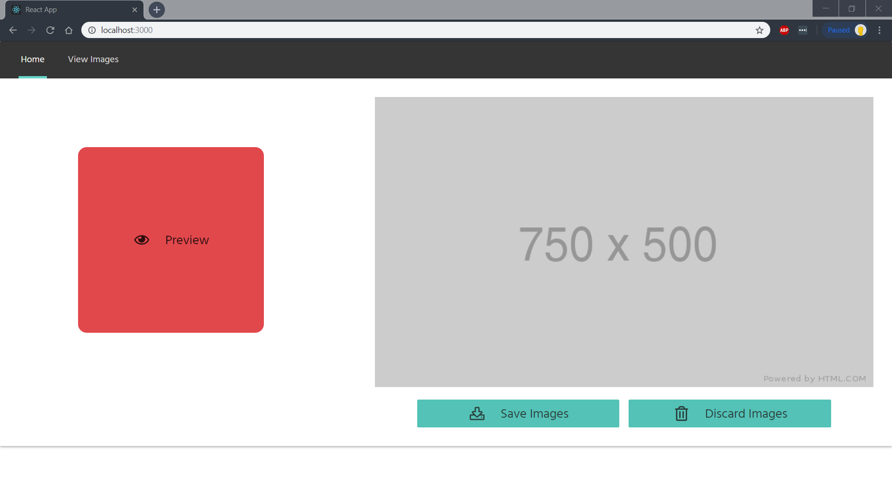
Notes:
Anthony

Slide 12
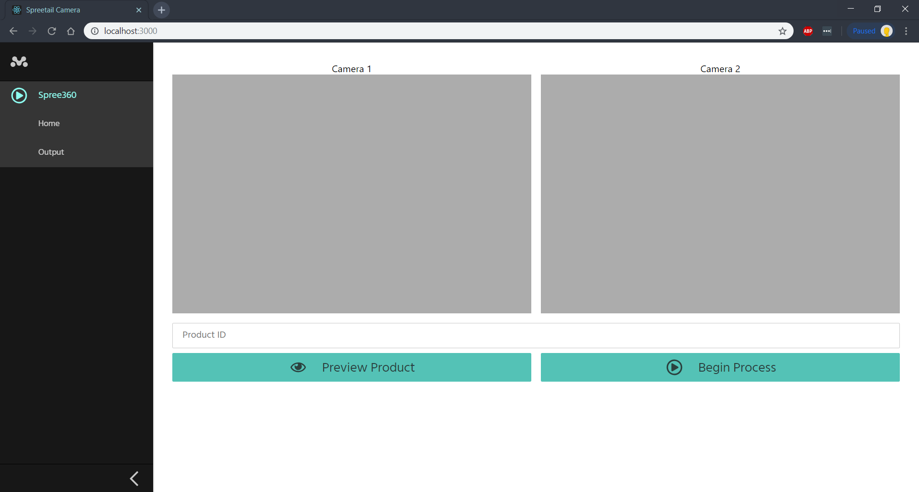
Notes:
Anthony

Slide 13
Progress
Communication Layer
Last release
Created a direct connection between the front end and hardware
Provided a simple interface to take a photo and send it back
This release
Scrapped the method of direct connection by HTTP
Introduced Azure Service Bus to the project
Reliable connectivity, messages require a key to send/receive, messages are customizable
Added more functionality for the front end to utilize when communicating with the cameras
Notes:
Jared

Slide 14
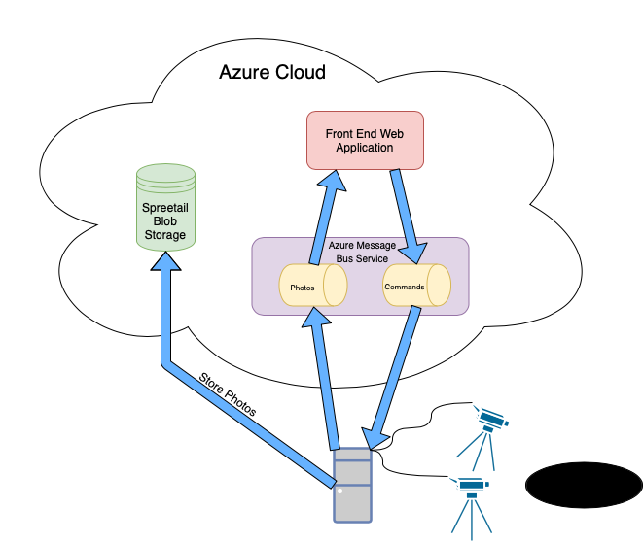
New Architecture
Web Application and Tower connected by “Middleman”
Middleman = Azure Message Bus Service
Two separate Message Queues
Command Queue
Photos Queue
Store messages until pulled
Save photos to storage through tower
Only send thumbnails to Front End
Smaller message = faster delivery
Less memory used to store photo on front end
Notes:
Jared

Slide 15
Progress
Communication Layer
In terms of functionality...
Last release
Had a simple command that would take a photo and send it back
This release
Added cherry-picking to delete photos user doesn’t want
Completed the ability to perform a full 360 take or a preview shot
Utility functions to load photos, downsize to a thumbnail, and prepare for sending
Unit testing to prove accurate functionality
Notes:
Jared

Slide 16
Progress
Communication Layer
Performance
Taking an image, placing it on the hardware, downsizing, and sending
Direct connection with HTTP: ~15 seconds
Through Azure Service Bus: ~5 seconds
Sending 50 downsized photos to the front end queue (only measured using service bus)
Photos were already on the hardware
Able to send out every photo within 20 seconds, receiving would take roughly the same amount of time
Sending and receiving can be done in parallel, meaning once one photo is sent from the tower then the front end can immediately consume it from the queue and wait for the next
Notes:
Jared

Slide 17
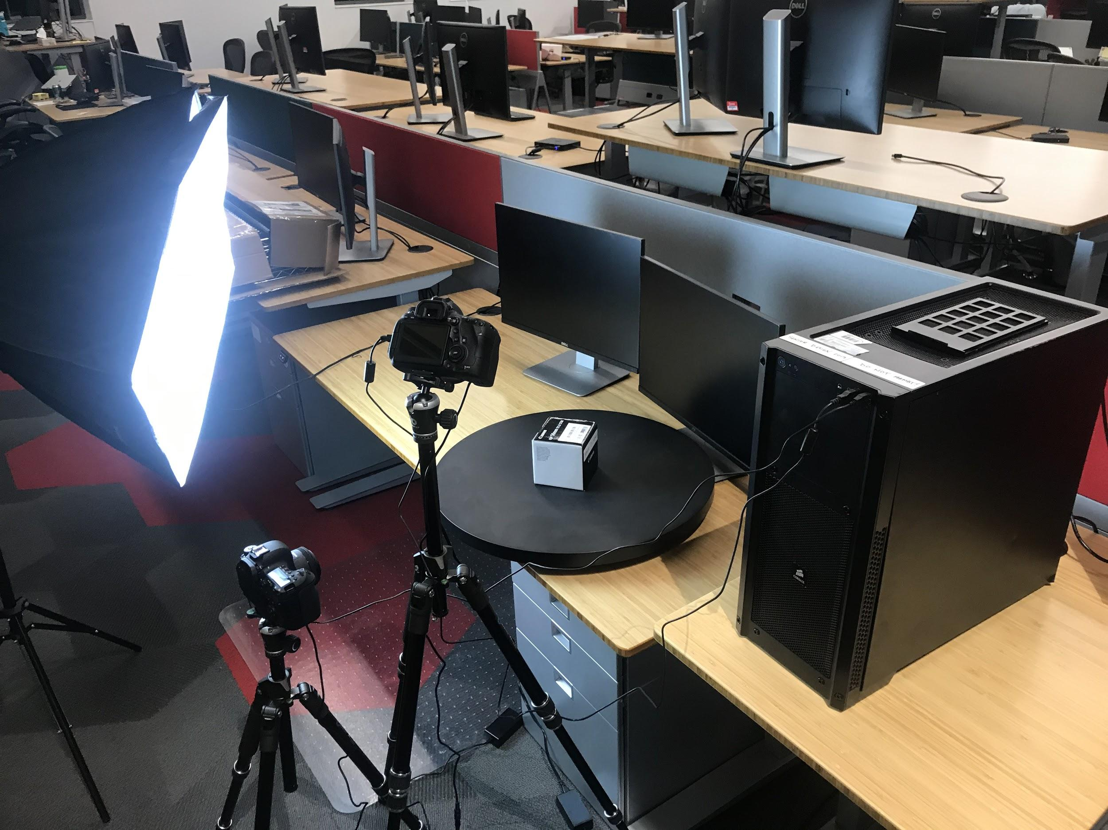
Progress
Hardware Setup
Last Release
Software for one camera
Single Camera capture
Decent image quality
This Release
Ordered and received final components
Put together full working hardware rig
Wrote and tested software to control both cameras simultaneously
High image quality
All code builds in docker container and docker container builds in Gitlab CI
Notes:
Li

Slide 18
Progress
Blockers along the way
Web server with HTTP could only work on local network
Hard to send many photos at once
Switched architecture to use Azure Message bus
Connect from anywhere
Send many photos back to back quickly
Azure setup in Web Application
Many connection issues and errors trying to connect to Azure Message Service
Found and used necessary authentication keys to connect
Continuous Integration build issues
Building docker containers in Gitlab CI caused errors
Debugged issues to allow docker commands to execute in CI
Notes:
Li

Slide 19

Previous Release
Notes:
Taher

Slide 20
Demo
Notes:
Errybody

Slide 21
Release 5
What to expect
View all images from 360 capture in web application
Ability to select photos to be saved to Spreetail Storage
Connection to Spreetail Azure blob to save images
Notes:
Li

Slide 22
Questions?
Notes:
Errybody

Slide 23
Notes:
Errybody

